Slide 1
Data and Controls: My 24M Experience
Ethan Neidhart
07/01/2015

Slide 2
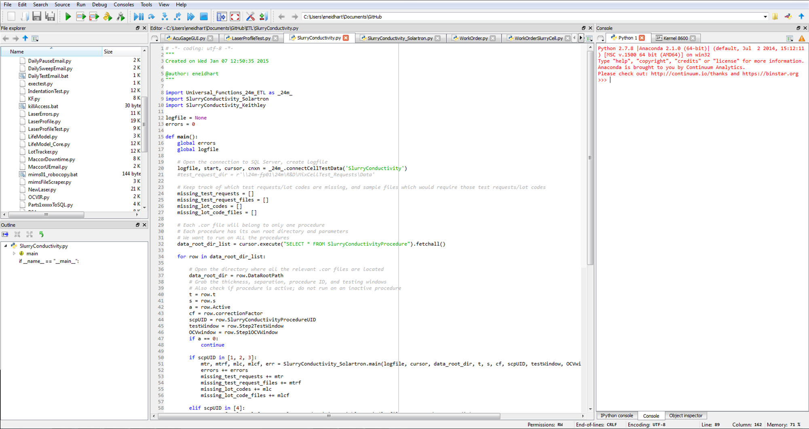

Slide 3
What do I do here?
Database
Issues
Script is causing errors
Script needs an improvement
Projects
New script/program needed
Old script/program needs major update

Slide 4
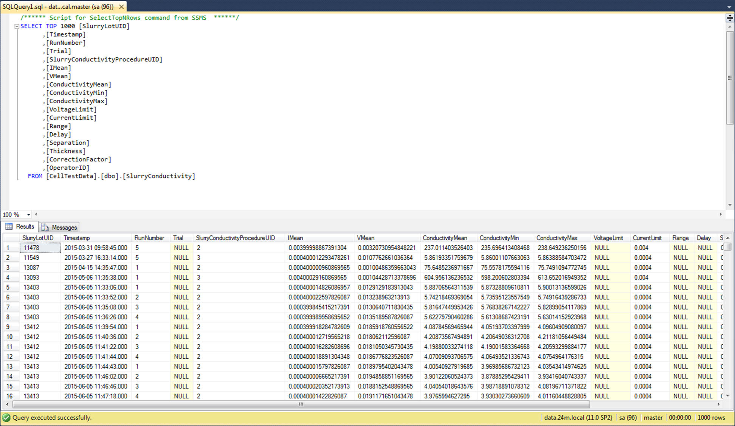

Slide 5


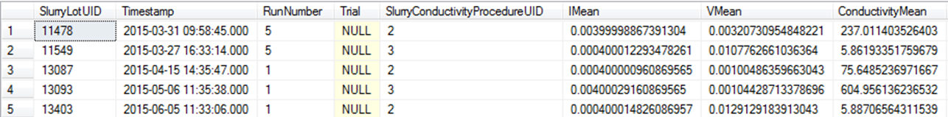
Database
SQL Queries:
Pull information from data tables
Push information to data tables
MERGE into SlurryConductivity AS T
USING (SELECT ?, ?, ?, ?, ?, ?, ?, ?, ?, ?, ?, ?, ?, ?, ?, ?, ?, ?) AS S (SlurryLotUID, Timestamp, Run, Trial, SlurryConductivityProcedureUID, IMean, VMean, ConductivityMean, cmin, cmax, v, c, r, d, s, t, cf, op)
ON S.SlurryLotUID = T.SlurryLotUID AND S.SlurryConductivityProcedureUID = T.SlurryConductivityProcedureUID AND S.Run = T.RunNumber AND (S.Trial = T.Trial OR (ISNULL(S.Trial, 'A') = 'A' AND ISNULL(T.Trial, 'A') = 'A'))
WHEN MATCHED THEN UPDATE SET T.IMean = S.IMean, T.VMean = S.VMean, T.ConductivityMean = S.ConductivityMean, T.Timestamp = S.Timestamp, T.ConductivityMin = S.cmin, T.ConductivityMax = S.cmax, T.VoltageLimit = S.v, T.CurrentLimit = S.c, T.Range = S.r, T.Delay = S.d, T.Separation = S.s, T.Thickness = S.t, T.CorrectionFactor = S.c, T.OperatorID = S.op
WHEN NOT MATCHED BY TARGET THEN INSERT (SlurryLotUID, Timestamp, RunNumber, Trial, SlurryConductivityProcedureUID, IMean, VMean, ConductivityMean, ConductivityMin, ConductivityMax, VoltageLimit, CurrentLimit, Range, Delay, Separation, Thickness, CorrectionFactor, OperatorID)
VALUES (S.SlurryLotUID, S.Timestamp, S.Run, S.Trial, S.SlurryConductivityProcedureUID, S.IMean, S.VMean, S.ConductivityMean, S.cmin, S.cmax, S.v, S.c, S.r, S.d, S.s, S.t, S.cf, S.op);
Table structure:

Slide 6
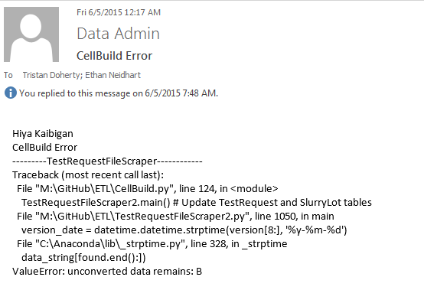

Slide 7
Issues
CellBuild script runs nightly
CellBuild runs almost all of our ETL scripts!
Sends out emails when something goes wrong
Begin the error tracking cycle!
Include more detailed logging around “afflicted” area
Run script; view output/log file
Analyze error source; apply changes
Run script again and repeat as necessary
Often fixed by the end of the day

Slide 8
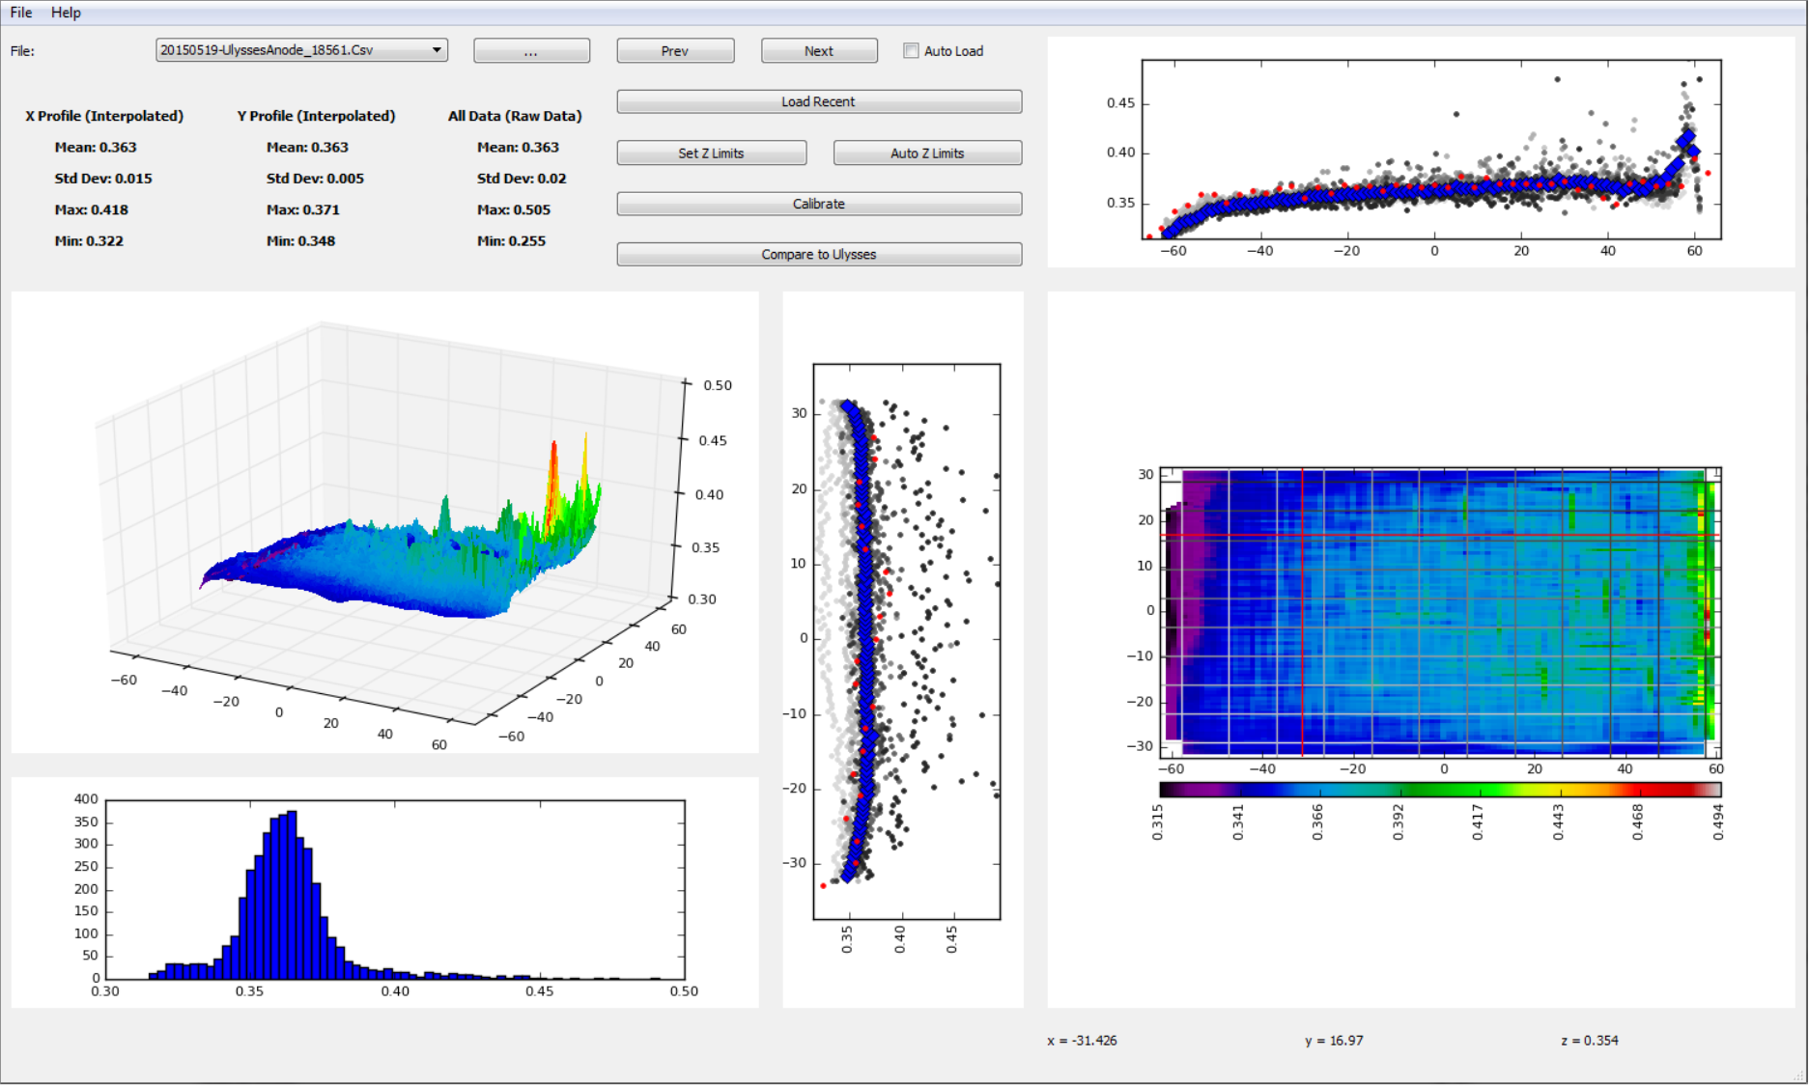

Slide 9
Projects
Someone (Tristan) comes to me with an idea for a new data project
New tests, equipment, procedures, etc. often require writing lots of Python
May take hours, days, or weeks to complete!
Remote script execution has been in development for months!
Major Projects list:
Slurry Conductivity Script
Incubator Control GUI
Ulysses Laser Script
Remote Script Execution Site (Beta)
Acu-Gage Laser GUI

Slide 10
Slurry Conductivity Script
Goals:
Obtain conductivity values for each .cor file on fp-01
Upload that data to the database
What it does:
Set up for file path architecture
Establish “root directory”
Run through each folder in root directory
Run through each file in a given folder
Extract voltage and current data
Calculate conductivity
Take averages
Push to SlurryConductivity Table

Slide 11
Incubator Control GUI
Goals:
Write a script that sends VWR’s commands to the incubator’s serial port
Create advanced controller and simple controller in the same program
Turn Python script into .exe that anyone can run
What it does:
Advanced controller lets user select a command from a list and execute it
Simple controller just lets user change temperature
Easily switch between the two controllers
Both have a “status window” for current temperature, error status, etc.

Slide 12
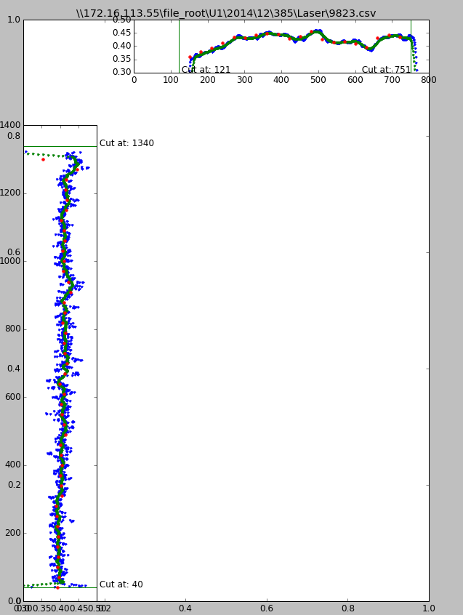
Ulysses Laser Script
Goals:
Obtain laser output files for each Ulysses and Allagash electrode
Essentially just 2D arrays of thickness values
Generate “side profiles” by taking average of each row or column
Determine “data window”
Filter “noisy” data
Reduce data (1400 points is a lot for one profile)
Only run on electrodes that need to be processed
Only run on electrodes with “good data”
Results:
Runtime reduced from an hour to a few minutes
Data window isn’t perfect, but it’s close
Filtering still needs work
How much of that “noise” is real?
What do we do about it?

Slide 13
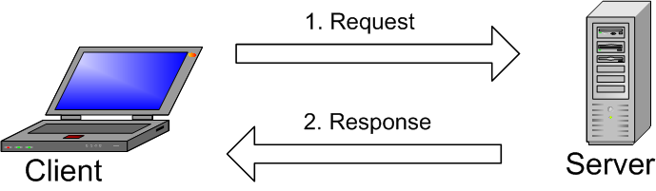
Remote Script Execution Site (Beta)
Goals:
Create a website where a user can run any ETL script on demand
Easy to use
Dynamic feedback
What it does:
User selects an ETL script to run, then clicks a button to run it (HTML)
PHP checks to see if that particular script is running
If it is, then it just displays an error message and won’t run it
PHP runs the script and waits for a response (log file content)
Once entire response is generated, prints it
EventSource/Server-Sent Events would make this dynamic and a LOT more user-friendly
PHP has issues with some ETL scripts

Slide 14
Acu-Gage GUI
Much more accurate than Ulysses Laser
Does not run automatically
Does not run quickly
Takes data in from a “raster” or snake-like pattern
Goals:
Take thickness data produced by Acu-Gage laser
Display it in a clear, organized manner
Add more features (like histogram, interactive top view, etc.)
What it does:
Best explained by demonstration!

Slide 15



My Best Friends

Slide 16
What I’ve learned
What to do when you don’t know what to do
Google-fu
Always remember: RTFM and STFW
Sandbox– try SOMETHING!
(Just make sure not to break anything!)
Don’t be afraid to ask for help
Programming
Python syntax
System.out.println(“Hello World!”); vs. print “Hello World!”
File I/O
SQL Queries (and integrating it with Python)
GUIs
Real Applications– No “Here you go, Professor”
What I like doing
GUIs
Not web development
Handling/processing data
It’s like a puzzle!

Slide 17
Questions?

